Slide 1


There was a man who had four sons.
He wanted his sons to learn not to Judge things too quickly.
So he sent them each on a quest, in turn,to go and look at a pear tree that was a great distance away

Slide 2

The first son went in the winter,
the second in the spring,
the third in summer,
and the youngest son in the fall.

Slide 3

When they had all gone and returned, he called them together to describe what they had seen

Slide 4

The first son said that the tree was ugly, bent, and twisted.
The second son said it was covered with green buds and full of promise.

Slide 5

The third son disagreed; he said it was laden with blossoms that smelled so
sweet and looked so beautiful, it was the most graceful thing he had ever
seen.
The last son disagreed with all of them; he said it was ripe and
drooping with fruit, full of life and fulfillment.

Slide 6

The man then explained to his sons that they were all right, because they
had each seen only one season in the tree's life.

Slide 7

He told them that you cannot judge a tree, or a person, by only one season.
That the essence of who they are, and the pleasure, joy, and love that
come from that life, can only be measured at the end, when all the seasons
are up.

Slide 8

If you give up when it's winter,
you will miss the promise of your
spring, the beauty of your summer,
And the fulfillment of your fall.

Slide 9

Don't let the pain of one season destroy the joy of all the rest.
Don't judge life by one difficult season.

Slide 10

Persevere through the difficult patches,
and better times are sure to come in time.

Slide 11

Aspire to Inspire….Before You Expire

Slide 12

Live Simply. Love Generously. Care Deeply. Speak Kindly.
And leave the rest to God.

Slide 13

Happiness keeps You Sweet,
Trials keep You Strong,

Slide 14

Sorrows keep You Human

Slide 15

Failures keep You Humble

Slide 16
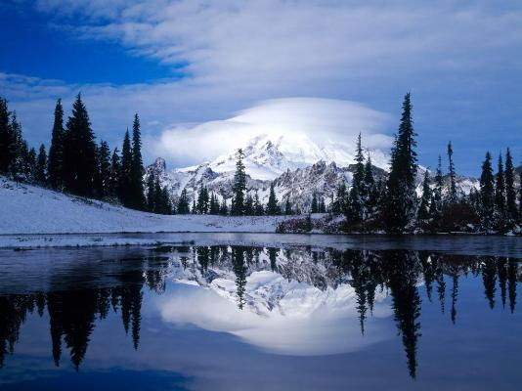
Success keeps You Growing,

Slide 17

But Only God keeps You Going

Slide 18

Take care and be safe for me.

Slide 19



Slide 20


God Bless you and keep you in his care
through all the seasons of your life!

